Slide 1
Chapter 7
Advanced SQL
Database Systems:
Design, Implementation, and Management, Sixth Edition, Rob and Coronel

Slide 2
UNION Query
Combine two companies customer lists where they have names in common so that the final list has no duplicate names
  Column names and their attributes must be the same
  SELECT <COLUMN NAMES> FROM CUSTOMER
  UNION
  SELECT <COLUMN NAMES> FROM CUSTOMER_2;
Can include more than two tables where applicable
  SELECT <COLUMN NAMES> FROM T1 UNION
  SELECT <COLUMN NAMES> FROM T2 UNION
  SELECT <COLUMN NAMES> FROM T3;

Slide 3
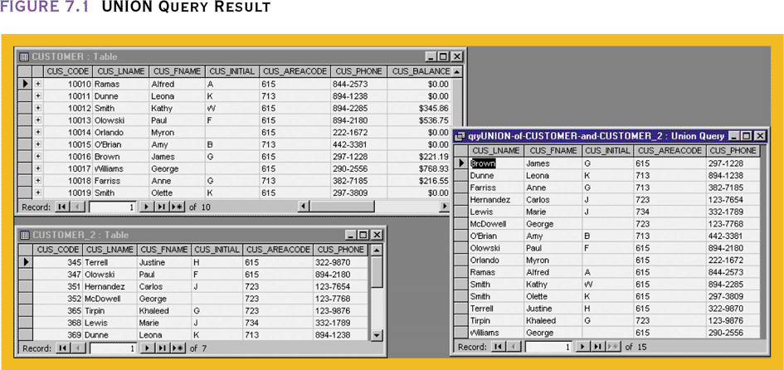
UNION Query Result

Slide 4
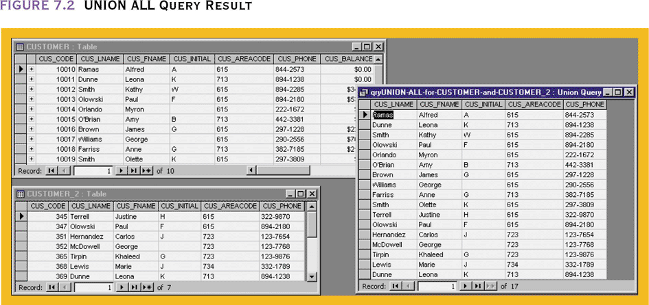
UNION ALL Query Result
UNION ALL merges the tables but keeps duplicates in the result table

Slide 5
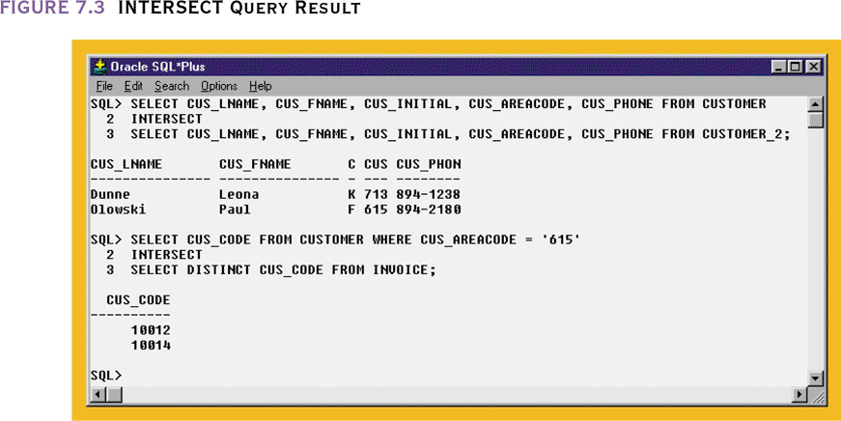
Intersect Query
Find the rows that are in both tables
Find rows based on another select
Not available in MS Access
Alternative
SELECT CUS_CODE FROM
CUSTOMER
WHERE CUS_AREACODE=‘615’
AND CUS_CODE IN
(SELECT DISTINCT
CUS_CODE FROM INVOICE);

Slide 6
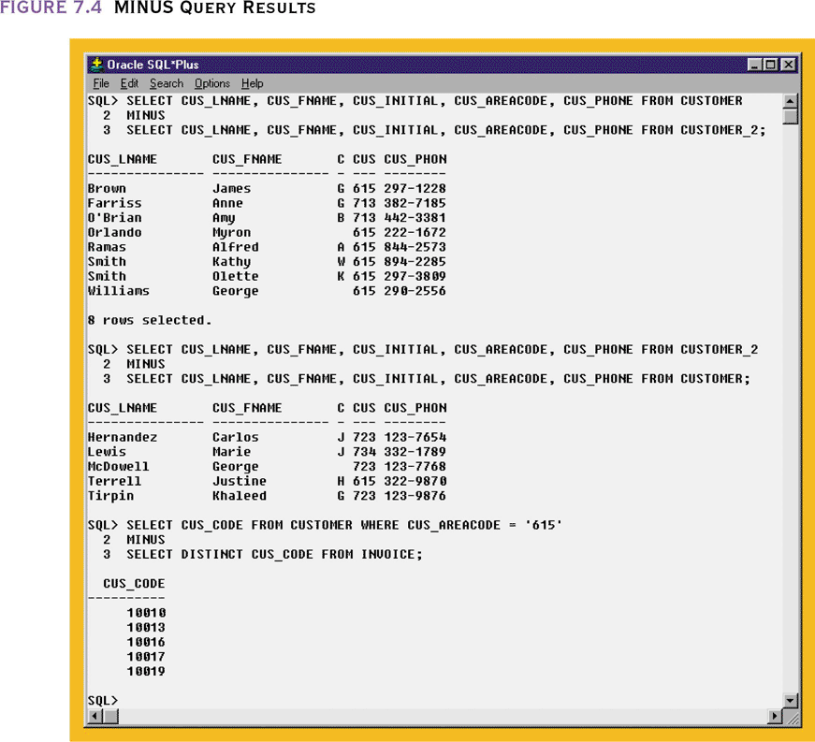
Minus Query
Combines rows from two queries and returns only those rows that appear in the first set but not the second
Alternative – use NOT IN
Customers located in area code 615 minus the ones who have made purchases i.e., these “615” customers did not make purchases

Slide 7
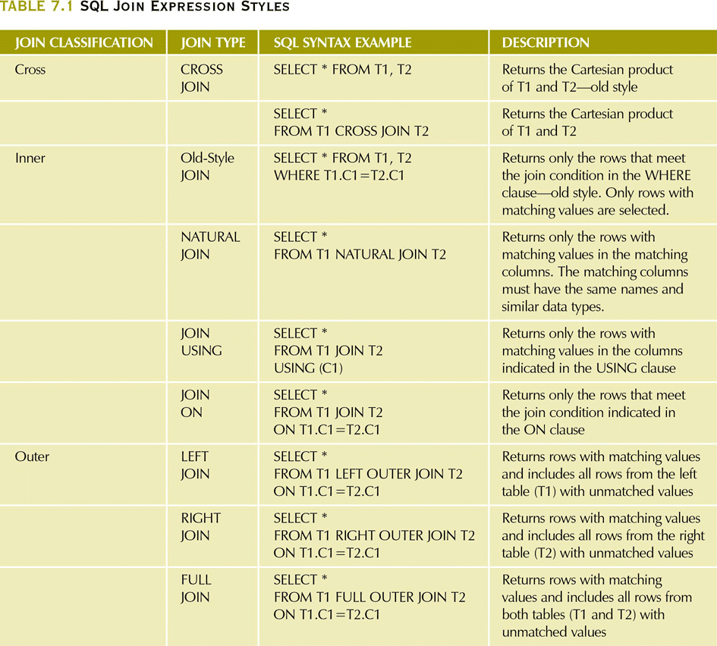
SQL Join Expression Styles

Slide 8
Additional clauses with JOIN
JOIN USING – return only the rows with matching vales in the column indicated in the USING clause
  This column must exist in both tables
  SELECT column-list FROM table1 JOIN table2 USING (common-column)
JOIN ON – when the tables have no common attribute name but the columns have the same attribute type
  SELECT column-list FROM table1 JOIN table2 ON join-condition

Slide 9
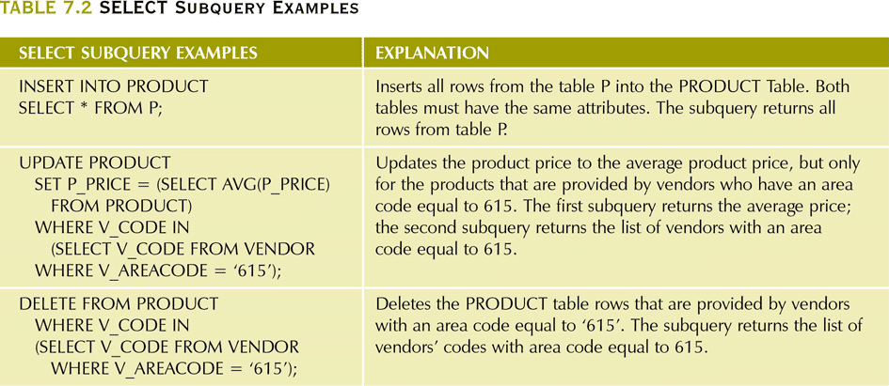
SELECT Subquery Examples

Slide 10
WHERE Subquery Examples
Subquery can return
  One single value (one column, one row)
  A list of values (one column, multiple rows)
  A virtual table (multicolumn, multirow set of values)
  NULL

Slide 11
Other types of subqueries
  IN subqueries – you want to find all customers who have purchased something from a list of products, not just one product
  HAVING subqueries – restrict a GROUP BY by applying a conditional criteria to the grouped rows
    List al products with the total quantity sold greater than the average quantity sold
  INLINE subqueries – can appear as a value in a the columnlist of a SELECT
    Must return one value
      Compute difference between product’s individual price and its average price
  CORRELATED subqueries – subquery executes once for each row in the outer row (like nested loops)

Slide 12
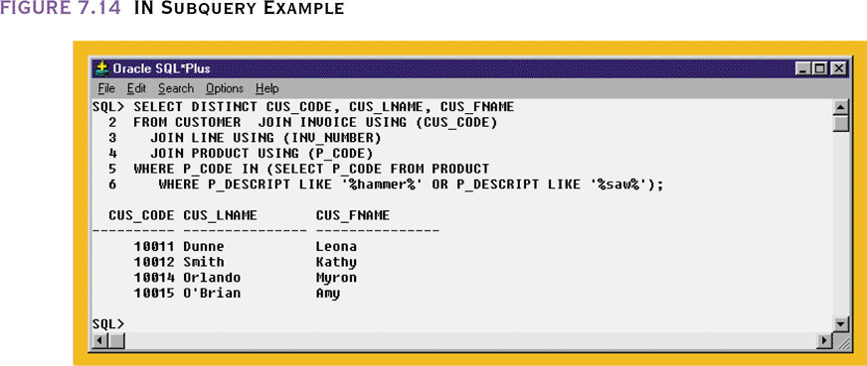
IN Subquery Example

Slide 13
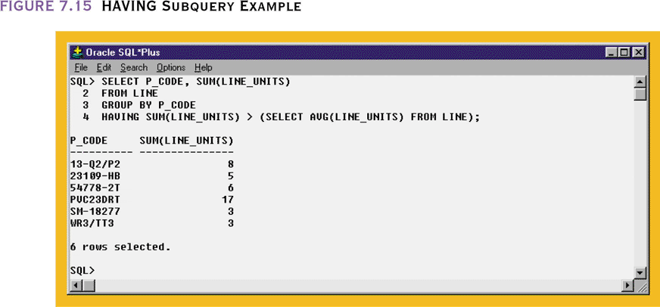
HAVING Subquery Example

Slide 14
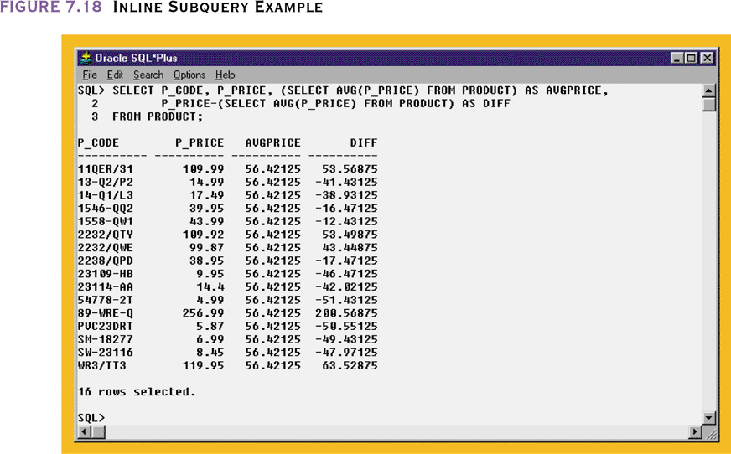
Inline Subquery Example

Slide 15
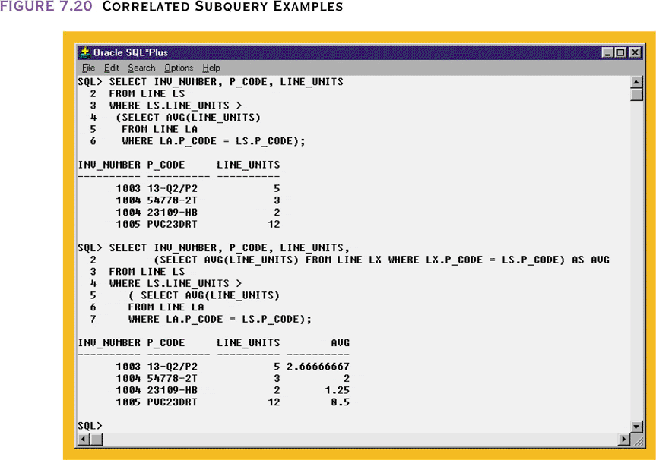
Correlated Subquery Examples

Slide 16
Updatable Views
Views can be made to serve common data management tasks
  Batch update routine – pools multiple transactions into a single batch to update a master table file in a single operation
  Updates attributes in the base tables that are used in the view
    Update a product’s available inventory based on summary sales transactions

Slide 17
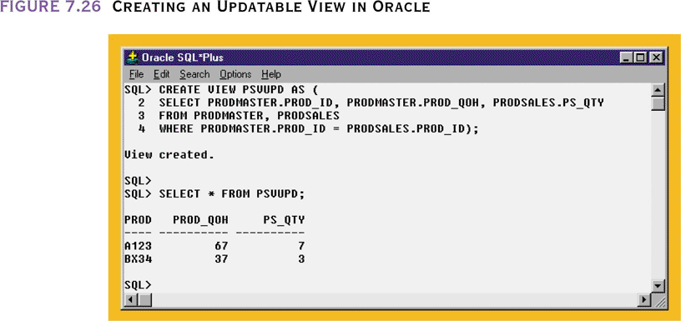
Creating an Updatable View in Oracle

Slide 18
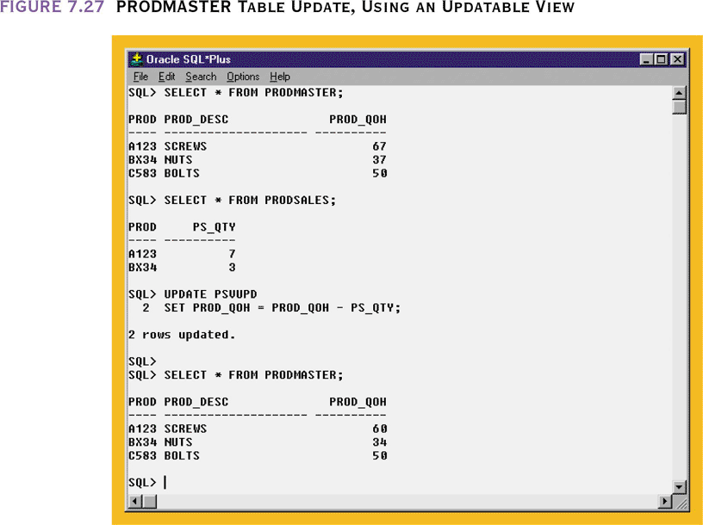
PRODMASTER Table Update,
Using an Updatable View

Slide 19
Procedural SQL
SQL does not support the conditional execution of procedures (IF-THEN-ELSE) or loops
One way to do this is by writing procedural code in a programming language and including SQL statements in the progam
  This spreads out SQL code in many programs and make changes difficult
A better way is to isolate critical code and have all applications call this shared code
  Needed by distributed and OO databases
  SQL 99 defined the use of persistent stored modules (PSMs)

Slide 20
Procedural SQL
A PSM is a block of code that is stored and executed at the DBMS server
  Represents business logic that can be shared among multiple database users
  Access can be controlled by the DBA
  Oracle supports this through Procedural SQL – PL/SQL

Slide 21
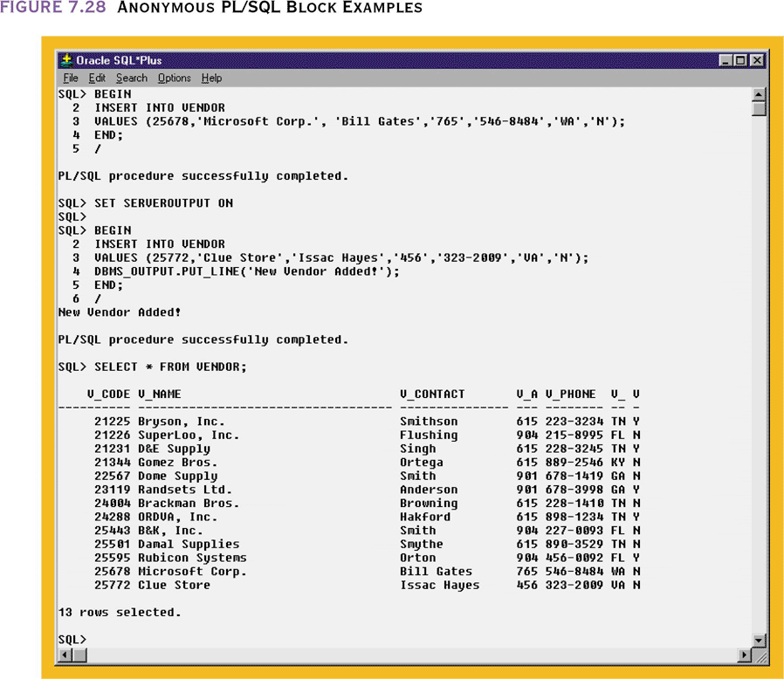
Anonymous PL/SQL Block Examples

Slide 22
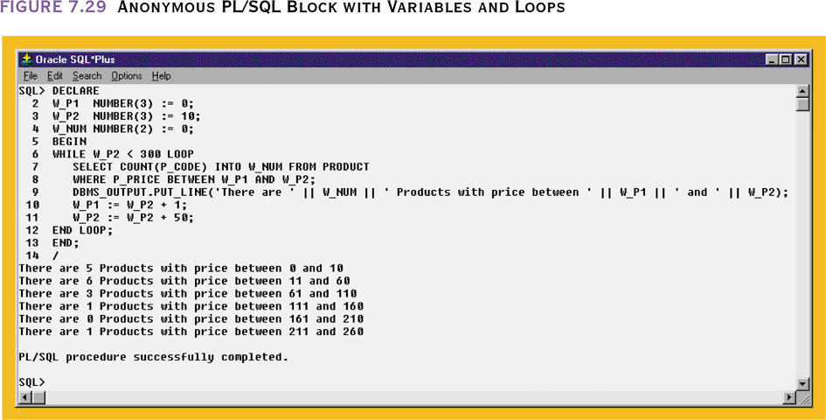
Anonymous PL/SQL Block with Variables and Loops

Slide 23
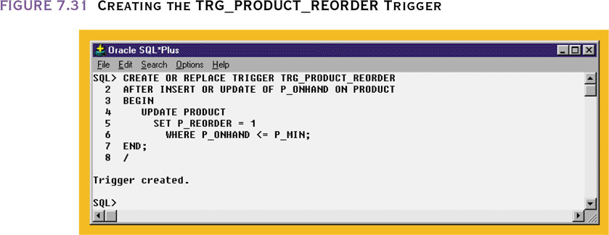
Creating a Trigger using PL/SQL

Slide 24
Stored Procedures: Advantages
Substantially reduce network traffic and increase performance
No transmission of individual SQL statements over network
Help reduce code duplication by means of code isolation and code sharing
Minimize chance of errors and cost of application development and maintenance

Slide 25
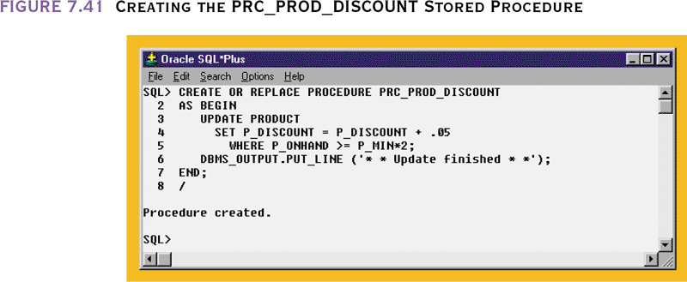
Creating the PRC_PROD_DISCOUNT Stored Procedure

Slide 26
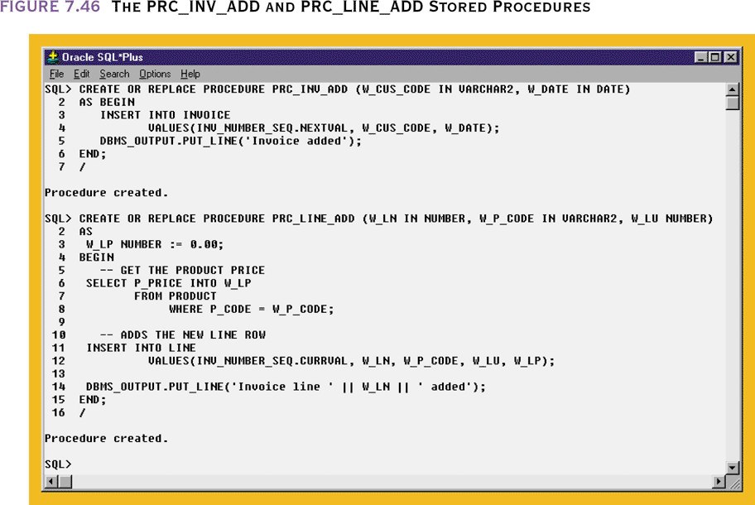
The PRC_INV_ADD and PRC_LINE_ADD Stored Procedures

Slide 27
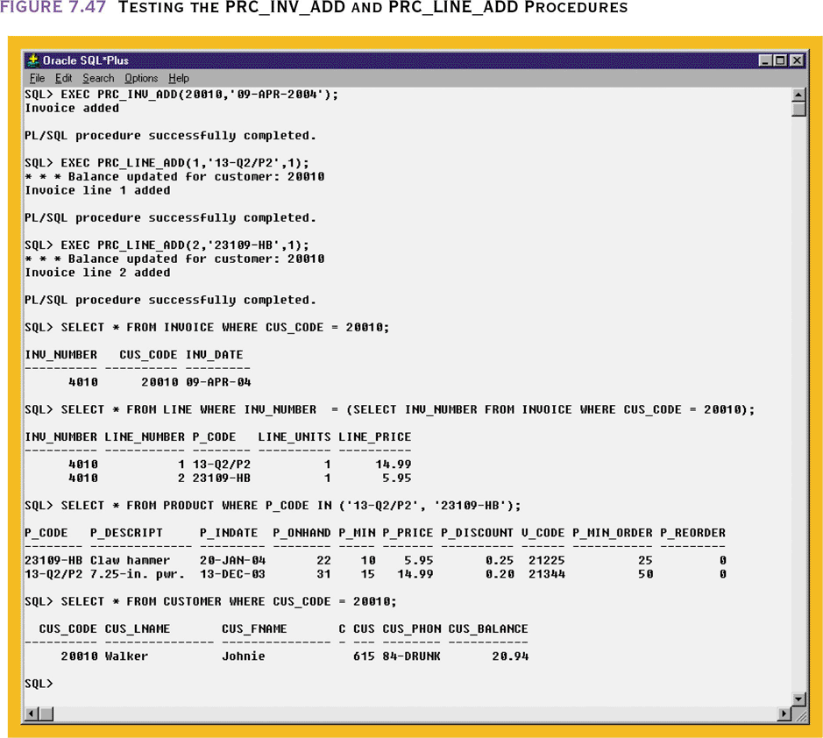
Testing the PRC_INV_ADD and PRC_LINE_ADD Procedures

Slide 28
Embedded SQL
SQL statements that are contained within an application programming language
In some programming languages the SQL code is preceded by EXEC SQL and followed with END-EXEC
  SQLSTATE and SQLCODE reporting variables inform the program of the status of the SQL code that executed

Slide 29
Dynamic SQL
SQL statement is not known in advance, but instead is generated at run time
Program can generate SQL statements at run time that are required to respond to ad hoc queries
Attribute list and the condition are not known until the end user specifies them
Tends to be much slower than static SQL
Requires more computer resources

